Slide 1
Agile Software Development
Md. Mizanur Rahman (Milon)
CTO, CheesecakeICT
Technical Lead | CSMTM | PMP | Agile Thinker | Learner | Reader
14.05.2019

Slide 2
Objectives
Promote best practice and agile software engineering
  Introduction
  Processes
  Methods
  Practices and principles
  Tools
Practice on a real world project
  Room booking system
  Facilitates learning and understanding
  Applying best practices

Slide 3
Introduction
Most Programmers
  write a small program without much planning or forethought
  write the program without following a well defined process
Size and Complexity
  It's relatively easy for one or two people working together to complete a small project given stable requirements. As the size and complexity of a project grows the importance of following a well-defined process increases proportionally.
Software Process
  A software process organizes and prescribes the activities necessary to write software (descriptive process).
  Development processes may be more or less prescriptive.
  Prescriptive vs Empirical processes; Agile methods are more empirical; Larman 2004, page 32
  There are process procedures and guidelines you can follow that will assure you a very high probability of success.

Slide 4
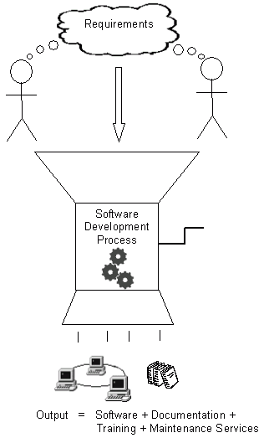
Introduction (Conti…)

Slide 5
Processes, Methods and Practices
Process, Methodology – A description of project activities and their order
  Examples: Waterfall, Iterative and Incremental, Agile - Scrum
Method – A description of the way a developer works
  Examples: Scrum, XP, architecture and design modeling
Practice – A description of how the developer solves his day-to-day work
  Examples: Design by Contract, TDD, Pair Programming, UML modeling
Tool – Software, equipment, standard to help the developer do his job
  Examples: VS IDE, NUnit, FitNesse, VSS CMS, MSBuild, CC, UML
There is not always a distinct difference between process, method and practice

Slide 6
Processes
Waterfall
Iterative and Incremental
Agile (Scrum)

Slide 7
What is a Software Development Process
Defines Who is going to do What
When to do it, and
How to reach a certain goal
New or changed requirements
Software Development Process
New or changed System

Slide 8
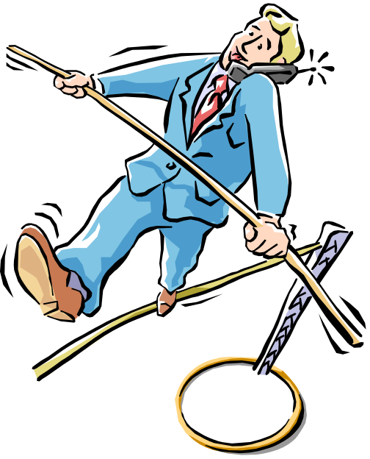
Characteristics of a Software Development Process
Characteristics of a good process
  Provides guidelines for efficient development of quality software
  Reduces risk and increases predictability
  Promotes a common vision and culture
  Presents the currently best practice
We will look at three processes
  Waterfall
  Iterative and Incremental
  Agile (Scrum)
    One of several agile methods
    XP, DSDM, Crystal, FDD, Lean
Processes have different properties
  Choose one that fits your project
Notes:
XP: eXtreme Programming, Kent Beck et al
DSDM: Dynamic System Development Method, DSDM Consortium, UK
Crystal: Crystal Clear and other Crystal methods by Alistair Cockburn
Evo: Evolutionary development, Tom Gilb
FDD: Feature Driven Development, Jeff De Luca
Lean: Lean Software Development, Mary and Tom Poppendieck

Slide 9

The Waterfall Model
Phases:
  Requirements Gethering
  Requirements Analysis
  System Analysis & Design
  Implementation & Unit Testing
  Acceptance Testing (UAT)
  Deployment
  Maintenance
One phase is closed and approved before the next one is started
  Various models for iterating back to adjust previous phases

Slide 10
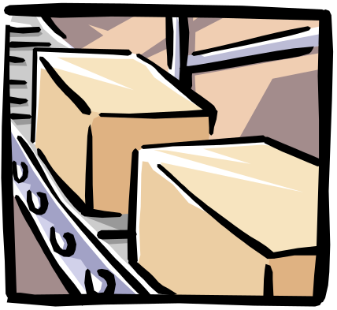


The Waterfall Model (Continue …)
Many of us are familiar with the Waterfall Model – it is a “framework” for the software development process
Stepwise model from a requirements phase to finished product
  Waterfall Model talks about “development activities through time”
  Waterfall Model talks about “teams of people”
Development activities | Teams
Divide the work into stages | A separate team of specialists for each stage
At each stage, the work is passed from one team to another | Some coordination is required for the handoff from team to team – using “documents”
At the end of all of the stages, you have a software product ready to ship | As each team finishes, they are assigned to a new product

Slide 11
The Waterfall Model (Continue …)
Stepwise model from a requirements phase to finished product
  Managing the Development of Large Software Systems
  Recognised the need for feedback loops between stages
  “I believe in this concept, but the implementation described above is risky and invites failure”
    Because of corrections coming from running the system
Requirement
Design
Coding and unit test
System Integration
Maintenance

Slide 12
Waterfall Advantages and Drawbacks
Easy to understand, linear
  Everything is well planned before producing
  Avoids surprises by features not thought of
Assumes world and understanding is static
  Adapts badly to changes in understanding and environment during development
  Adapts badly to limited resources, all requirements are approved and need to be delivered, although sufficient value for money may be obained with less

Slide 13
Waterfall Model (Video)
https://www.youtube.com/watch?v=Y_A0E1ToC_I
https://www.youtube.com/watch?v=vDZfHqAwlkc

Slide 14
Iterative and Incremental Process
Incremental
  adding new functionality in small chunks
  Incremental development is done in steps from design, implementation, testing/verification, maintenance.
  The Waterfall Model is a traditional incremental development approach.
Iterative
  performing repeatedly, i.e. adding new functionality in a repetitive or cyclic manner
  Iterative development was created as a response to inefficiencies and problems found in the waterfall model.
  Agile Modeling is a typical iterative approach

Slide 15
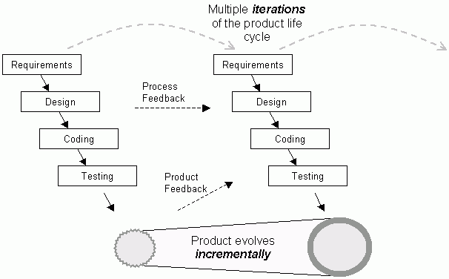
Iterative and Incremental Process

Slide 16
Iterative and Incremental (Video)
https://www.youtube.com/watch?v=9sGTrWjFpvI

Slide 17
Iterative and Incremental Process
Strengths
  Initial product delivery is faster.
  Customers gets important functionality early.
  More flexible – less costly to change scope and requirements.
  Each release is a product increment
  Customer can provide feedback to each product increment
  A series of mini-Waterfalls are performed before proceeding to the next increment
Weaknesses
  Overall requirements are defined before proceeding to evolutionary
  Each phase of an iteration is rigid and do not overlap each other.
  Identify risks and create development plan
When to Use
  Such models are used where requirements are clear and can implement by phase wise.
  Mostly such model is used in web applications and product based companies.

Slide 18

Agile Development
Agile Development – What does it mean?
  Agile is a set of practices, values, and principles for software product development.
  In software product development, we think about “methodologies,” “activities,” “interactions,” “results, work products or artifacts;” we think about “processes” that we use to organize the work
The core ideas in Agile Development
  Adaptive
  Iterative/incremental
  People-oriented

Slide 19
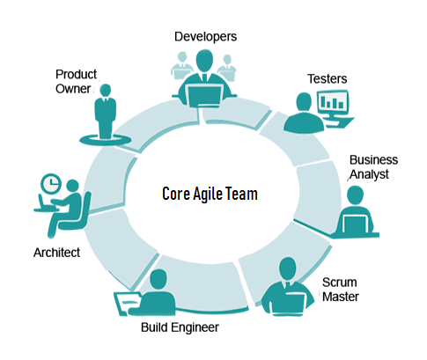
Agile Development
  Adaptive means that the teams and
  the process should be flexible in the
  presence of “rapid-fire change”.
  Iterative and incremental means that
  Agile Development produces working
  products in stages – a growing set of
  “completed and working software”.
  People-oriented means the team
  organization and processes will support
  good people, who are the most important
  ingredient to project success.

Slide 20
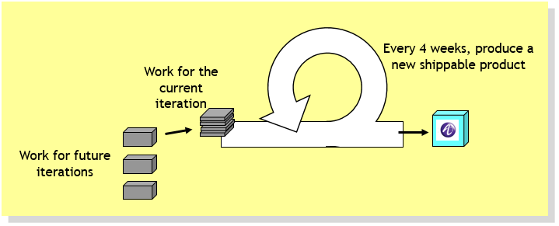
Agile Development
Main characteristics of Agile Development
  keep things small
  deliver partially-completed software frequently
  talk to the customer often
  write more code than documentation
  everyone on the team learns together

Slide 21
Agile Development - Manifesto
We are uncovering better ways of developing software by doing it and helping others do it. Through this work we have come to value:
An Eloquent Statement of Agile Values or Goals
  individuals and interactions over processes and tools
  working software over comprehensive documentation
  customer collaboration over contract negotiation
  responding to change over following a plan
That is, while there is value in the items on the right, we value the items on the left more.
Agile Alliance: http://www.agilealliance.org

Slide 22
Agile Development - Principles
  Highest priority is to satisfy the customer through early and continuous delivery of valuable software.
  Welcome changing requirements, even late in development. Agile processes harness change for the customer's competitive advantage.
  Deliver working software frequently, from a couple of weeks to a couple of months, with a preference to the shorter timescale.
  Business people and developers must work together daily throughout the project.
  Build projects around motivated individuals. Give them the environment and support they need, and trust them to get the job done.
  The most efficient and effective method of conveying information to and within a development team is face-to-face conversation.

Slide 23
Agile Development – Principles (Conti..)
  Working software is the primary measure of progress.
  Agile processes promote sustainable development. The sponsors, developers, and users should be able to maintain a constant pace indefinitely.
  Continuous attention to technical excellence and good design enhances agility.
  Simplicity--the art of maximizing the amount of work not done--is essential.
  The best architectures, requirements, and designs emerge from self-organizing teams.
  At regular intervals, the team reflects on how to become more effective, then tunes and adjusts its behavior accordingly.

Slide 24
Agile Development – Questions and Challenges
Documentation – it is still important in an Agile project.
  If it is the only kind of communication in your project, it isn’t good
  Real working code is more valuable than documents – less ambiguous
  Documents – easy to leave something out, easy to misinterpret
Development plans – also important in an Agile project
  the format of an Agile development schedule is a bit different from a conventional project plan.
  Development plan includes “iterations”
  Each iteration gives the team has a chance to incorporate what they learn, rather than just following a non-adaptive plan
  Contracts
  Customer collaboration is one way to reduce development costs
  Do you want to deliver “everything” the customer asked for in the original contract? No – if the customer no longer needs it, the extra code will increase maintenance costs
  Always ask: Who needs this feature and how does it contribute to the value of the product?

Slide 25
Agile Development – Why Important?
The world is a lot different today. A large feature set might only increase costs for the customer.
  There is a constant introduction of new technology
  New players enter the market,
  New requirements are added
  “Small is Beautiful”
  If we are listening to the customer, we will reduce our chances of being “blindsided” by a smaller, more flexible competitor
  Anything that helps reduce maintenance costs will contribute to the bottom line

Slide 26
Agile Development – How hard is it to be Agile?
“Don’t do Agile, be Agile”
  Just doing “development in iterations” isn’t enough
Agile Development is about
  Keeping the process lightweight
  Making real progress in each iteration
  Communicating – face-to-face when possible
  Actively gathering customer input – early and often
  Being willing to make minor changes to your process

Slide 27
Agile – Scrum
Uses an empirical rather than defined approach
  Suitable for development of unique products from unique specifications
  It is a meeting with attitude – good teamwork is necessary
Basic principles for the agile method Scrum
  Cross-functional – as a team, they have the skills needed to produce “done” product in a Sprint.
  Self-organization – Leave responsibility to self-organizing teams
  Transparency – Let anybody know what happens at any time
    Good news as well as bad ones are visible early
    So that intelligent people can take informed decisions about what to do
  Feedback – Work in a tight, empiric loop with the ”product owner” (customer)
    ”Sprints” of 2 – 4 weeks
  Self-assessment – Team retrospective after each sprint

Slide 28
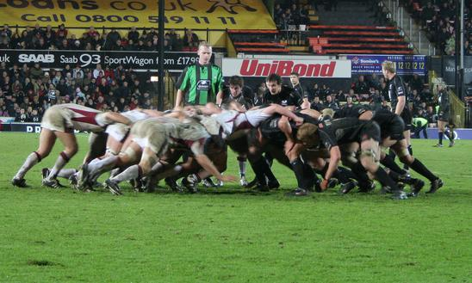
Scrum – The Art of the Possible
In English rugby football, a scrum is a way to put the ball into play
  The whole team is responsible for moving the ball towards the target
  Sometimes they succeed completely, sometimes only partially
http://commons.wikimedia.org/wiki/Image:Scrum_rugby.jpg

Slide 29
Scrum Highlights
Scrum roles
  Product owner (PO) responsibilities to describe and prioritize requirements
  Team responsibilities to produce within a time boxed ”sprint” (iteration)
  Scrum master (SM) responsibilities to enable team working conditions
Scrum practices
  Micro feedback, like daily scrum, sprint backlog, burn-down charts
  Macro feed-back and prioritization by product owner on every sprint,
    Product backlog
Scrum does not prescribe
  Solutions techniques, working methods, project progress plans
  These are up to the team to discover and adapt according to need
Suitable for projects with uncertain goals or moving targets
  Or where the way to get there is not completely known

Slide 30
Scrum Practices
Time boxing
  The incremental value of an activity decreases over time
  80/20 benefit achieved within time box
Potentially installable results
  Iterations (”sprints”) time boxed to 30 days (or shorter)
  Every iteration shall deliver custom value and production quality
Reduce initial elaboration (one day)
  Specify ”all” overall requirements for initial product backlog
    Main Use cases with scenarios, alt. user stories
    Primary actor roles
Prioritize and reprioritize
  Only work on what may be completed during next sprint (iteration)
  Specification and planning time box: one day

Slide 31
Scrum - Overview
The Scrum presentation is short and simple
  Product Backlog
  Iteration or Sprint Planning
  Sprint Backlog
  Task Estimation & Sprint or Iteration Estimation
  Daily Scrum Meeting
  Sprint or Iteration Review
  Retrospectives
Roles
  Team Member, Product Owner, and Scrum Master

Slide 32
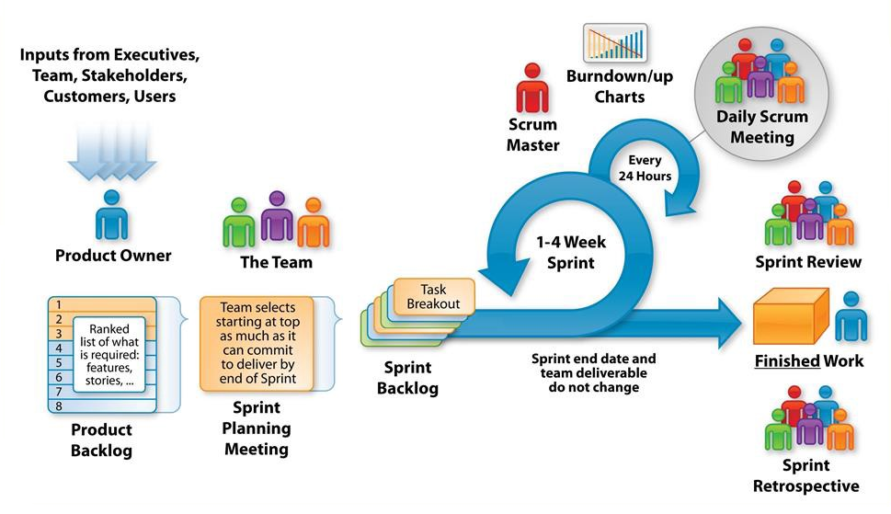
Scrum – Process Overview

Slide 33
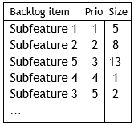
Scrum - Iteration Process
The Product Backlog is the set of all features and sub-features that you know you need to do to build the product
  This is the “plan” for multiple iterations
  The items in the Product Backlog is ordered by priority – value to the customer
    you want to deliver some value to the customer in each iteration, so you put the most important things early
  It is OK to add things to the Product Backlog at any time
A Scrum iteration (called a Sprint) contains a list of tasks and work product outputs that will be done in a 4-week time-box
  At the beginning of the 4 weeks, each team member has a pretty good idea of what they will be working on
  Management should not add new work product outputs to the Sprint – any new items should be added to the Product Backlog instead
  If new work items are important enough, they will get done in the next 4 week iteration

Slide 34
Scrum - Product Backlog
What does a Product Backlog look like?
  It is a simple spreadsheet
  All “Product Backlog Items (PBIs)” are in priority order
  Some PBIs are the names of “customer features”
    Could be a user screen, an interaction scenario or use case, a new report, a new algorithm
    Much, much smaller than a telecom system feature
  Some PBIs are internal tasks that contribute to the value of the product
    Can a design document be a PBI? Maybe.
    If it is a document that nobody reads, leave it out (because you are Agile)
    Can an early GUI prototype be a PBI? Certainly.
  Effort estimates – each PBI should have an “estimated effort” that is assigned by the team
  Should managers do the estimation of Product Backlog Items? No, never.
  Estimates must come from the team – and they should be realistic

Slide 35



Scrum - Roles on a Scrum Team
Product Owner
  Responsible for the ROI
  Available for the Team during the whole product development period
  Gets answers to all requirements questions
  Talks with customers and understands their priorities
  Keeps the Product Backlog current
Scrum Master
  “Servant leader” helping the Dev. team & PO use scrum to achieve the best possible results today, and improve their results in the future
  Owns “3 P’s”
    Process Coach
    Problem Solver
    Protector - Referee
  Could be a Dev. Team member or an ex-project manager but not the Dev. team’s boss

Slide 36
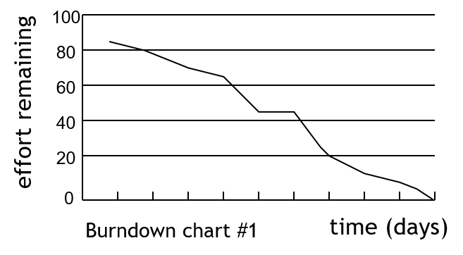
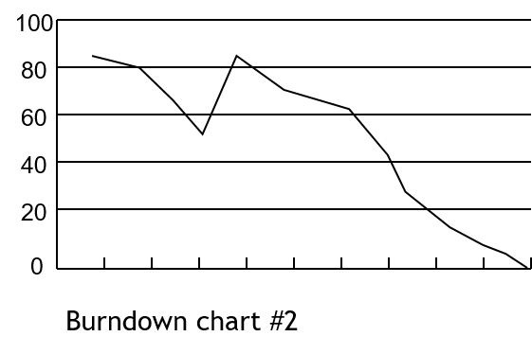
Scrum – Burndown Chart
A burndown chart tracks the amount of estimated effort remaining in the current iteration
  it should go down each day
  but if you discover that something is missing, or you have miss-estimated a difficult task, it could go up
  it’s OK: better to acknowledge reality early
Don’t make your estimates too pessimistic
  you will get a burndown chart that gets to zero well before the end of the iteration

Slide 37
Scrum – Sprint Planning Meeting
The Dev. Team, Product Owner, and ScrumMaster collaborate to create the plan for the Sprint (iteration)
  Product Owner provide the prioritized Product Backlog
  Dev. Team defines a goal for the Sprint, drawn from the items at the top of the PB’s(highest priority)
  Dev. Team creates a plan to achieve the goal (Sprint Backlog)
  ScrumMaster facilitates the meeting, and coaches as needed
Meeting is timeboxed to 2 hours X weeks in the Sprint
Scrum doesn’t say how to plan a Sprint – so they have to experiment to find the effective approach for them
  How detailed we need the requirement to be
  What unit to use in estimating – hours, point etc.
  How details a task breakdown is required

Slide 38
Scrum – Standup Meeting
Purpose
  Make progress, plans, and blocks visible to each other
Daily, the Dev. Team stands in a circle and reports
  What I have done yesterday
  What I am planning to do today
  What was the impediments
15 – minute timebox
  During meeting everyone listen, no discussion
  After meeting : farther discussion needed
Product Owner can attend but not must
ScrumMaster makes note of the blocks
No problem solving in the meeting – everything is taken offline later.
After daily scrum, ScrumMaster helps to remove blocks and people can meet in smaller groups to discuss issues

Slide 39
Scrum – Product Backlog Refinement
During each Sprint, the Dev. Team, Product Owner, and ScrumMaster look ahead to upcoming PBI’s (or User Stories) coming in the next 2-3 Sprints
They split larger items into smaller slices – ideally, small enough that 1-2 people could completely finish them in 3-4 days (“1-2-3-4”)
They start to get a more detailed understanding of the requirement for these upcoming PBI’s
No fixed format, timing, or timebox: try a 2-3 hour session for Dev. Team, Product Owner and ScrumMaster midway through the Sprint, Then inspect and adapt.

Slide 40
Scrum – Sprint Review
Stakeholders get “hands on” with the product
  They inspect the quality and doneness
  The inspect whether it serves the customer needs
  They try to find improvements to make in the future (PO adds these to the Product Backlog)
Get real-world customers or end users to attend and give hands-on feedback
Product Owner can do informal reviews during the Sprint, to catch misunderstanding

Slide 41
Scrum – Sprint Retrospectives
Purpose
  Iteration is good, because you have a natural breakpoint to apply some of what you have learned
  Inspect and Adapt to the process
Timeboxed
  An end-of-iteration retrospective meeting takes an hour or two
Dev. Team, ScrumMaster, and Product Owner talk together about how the Sprint went, both the positive and the negatives
They create a detailed plan of action for being more effective in the next Sprint
Probably the single most important practice in Scrum. We do this every Sprint!

Slide 42

Scrum – Estimation (Planning Poker)
Scrum is fun, so estimation is a game.
  The Delphi technique brought up-to-date - is a forecasting process framework based on the results of multiple rounds of questionnaires sent to a panel of experts. Several rounds of questionnaires are sent out to the group of experts, and the anonymous responses are aggregated and shared with the group after each round.
  Visibility of differences
  Drives to consensus
  Breaks down linear thinking

Slide 43
Scrum - Summary
Scrum summary
  Scrum is a “team-oriented” Agile methodology
  Short time-boxed iterations
  Each iteration produces some real software that has value to the customer
  Each iteration has
    iteration planning
    development work
    iteration review
  All estimation is done by the team
  Within a Sprint, the progress is tracked using a burn-down chart
  Product Owner determines the priorities in the Product Backlog
  Scrum Master helps enforce the rules of Scrum
  There is a 15-minute daily standup meeting to report

Slide 44
https://www.youtube.com/watch?v=2Vt7Ik8Ublw
THE END
THANKS

